Slide 1

Analysis of Obesity Levels Based On Eating Habits and Physical Condition.
M&I-ENG 621- Descriptive Analytics
Group 3:
Shivani Mangesh Sawant, Urvi Ravindra Dhomne, Sharmitha Chilankuri, Kallamadi Rutva

Slide 2

Introduction
Background:
Obesity is a significant global health issue linked to various chronic diseases,
including diabetes, cardiovascular conditions, and hypertension. Understanding the
factors contributing to obesity, such as dietary habits and physical activity levels, is crucial for developing effective intervention strategies.
Dataset:
Title: Estimation of Obesity Levels Based on Eating Habits and Physical Condition
Source: UCI Machine Learning Repository
No of Instances: 2111
No of Variables: 17
Objective:
To explore the relationship between eating habits, physical activity, and obesity levels, aiming to identify actionable insights for obesity prevention and management.

Slide 3

Dataset Overview
The dataset contains 16 independent variables and 1 dependent variable.
Variables:
Independent Variables: Age, Gender, Height, Weight, Dietary Habits (e.g., high-calorie food frequency), Physical Activity, and more.
Dependent Variable: Obesity Level (categorized into seven classes, e.g., Normal Weight, Overweight, Obesity Types I–III)
Sample Size: Diverse individuals aged 14–61 years, capturing a range of dietary and lifestyle behaviors.

Slide 4
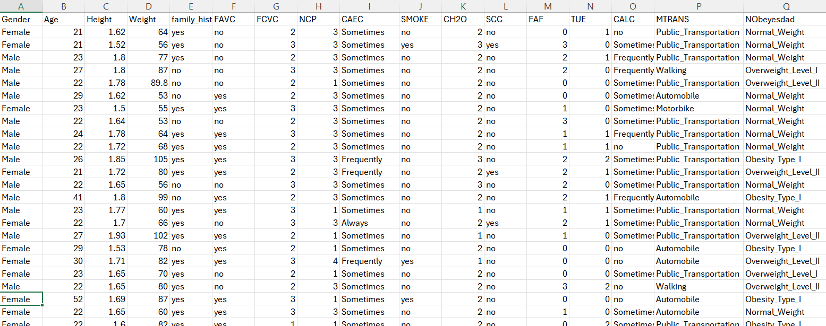
Dataset

Slide 5
Why Did We Choose This Project?
Global Health Significance
Obesity is a major public health issue worldwide, linked to chronic diseases like diabetes and cardiovascular conditions. Analyzing its determinants can contribute to developing effective prevention strategies.
Comprehensive Dataset
The chosen dataset provides a rich variety of variables, including dietary habits and physical activity, enabling a holistic analysis of factors influencing obesity levels.
Alignment with Academic and Professional Goals
This project combines our academic interests in data analysis with a real-world problem. It also helps develop critical skills in handling complex datasets, formulating hypotheses, and applying analytical techniques relevant to our coursework and future careers.
Need for Preventative Measures
Understanding the relationship between lifestyle factors (e.g., diet, physical activity) and obesity levels can guide the development of effective prevention and management strategies, reducing healthcare burdens.

Slide 6
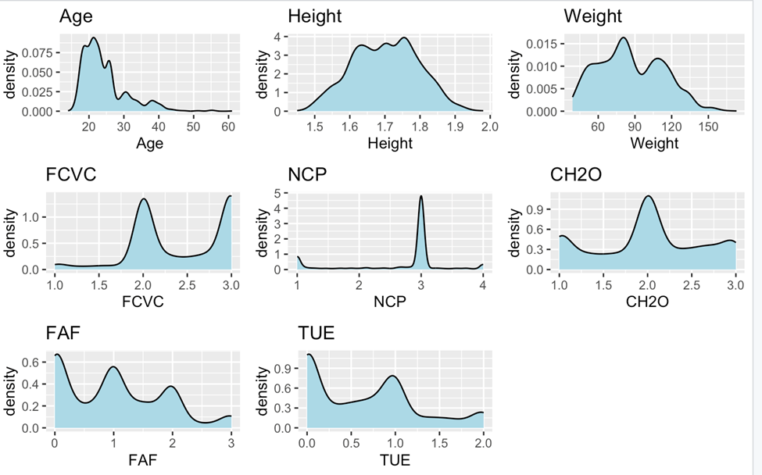
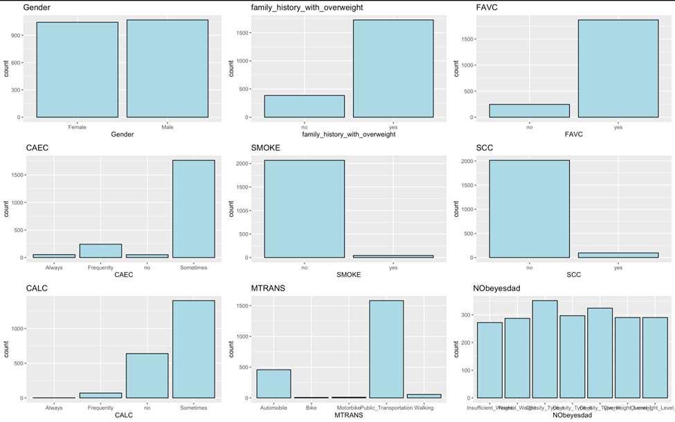
Statistical Analysis
Density Plot of Numerical Variables:
Bar Chart of Categorical Variables:

Slide 7
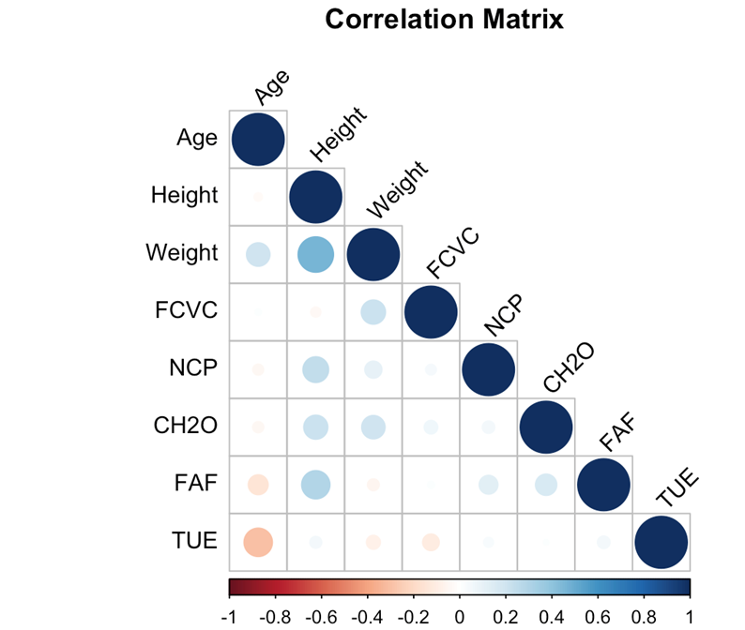
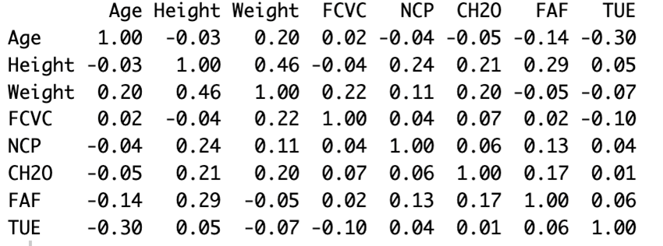
Statistical Analysis
We can see that the following variable pairs have relatively high correlations (above 0.5 or below -0.5):
Height and Weight (0.84)
FAVC and FCVC (0.74)
NCP and CAEC (0.68)
SMOKE and CH2O (0.67)
SCC and FAF (0.63)
FAF and TUE (0.57)
MTRANS and NObeyesdad (-0.65)

Slide 8
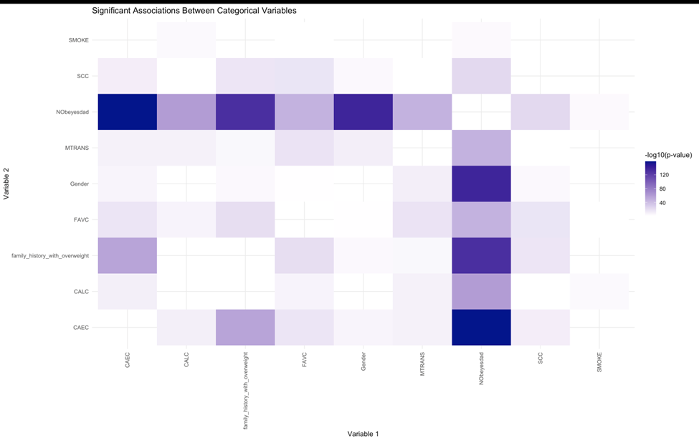
Statistical Analysis
Chi Square test for categorical variables associations
·There appears to be a strong association between Gender and several other variables, including FAVC (Frequent consumption of high caloric food), SMOKE, CH2O, and SCC. This suggests that gender plays a significant role in factors related to obesity & lifestyle.
· The variables NCP (Number of main meals) and CAEC (Consumption of food between meals) also show a notable association, indicating a relationship between the number of meals and the tendency to consume food outside of main meals.
· The variables FAF and TUE (Time using technology) exhibit a significant association, implying a link between body fat levels and the amount of time spent using technology.
· The variable MTRANS (Transportation method) shows a strong negative association with NObeyesdad (Obesity level), suggesting that the mode of transportation used is related to the obesity level.
· Other significant associations exist between variables like SMOKE and CH2O, SCC and FAF, and FAVC and FCVC (Frequency of consumption of vegetables), indicating complex relationships between lifestyle, dietary, and physiological factors.

Slide 9
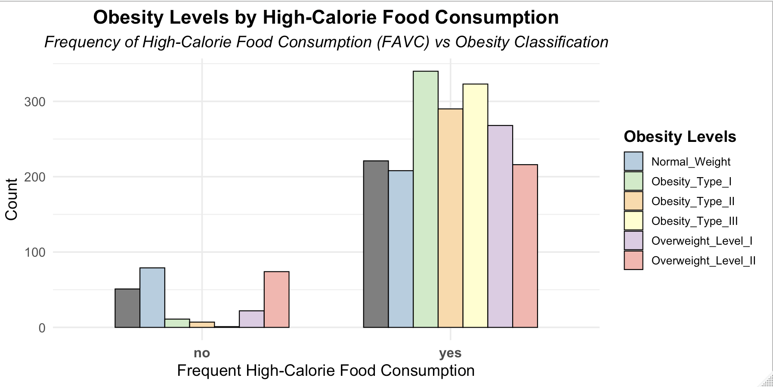
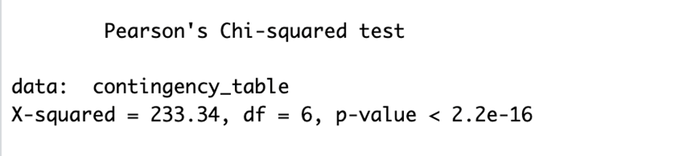
Research Hypothesis 1
Individuals with frequent consumption of high-calorie foods have a higher likelihood of obesity than those with infrequent consumption.

Slide 10
Research Hypothesis 1
Individuals with frequent consumption of high-calorie foods have a higher likelihood of obesity than those with infrequent consumption.
Chi-Square Test Results: The Chi-Square test results show a statistically significant association between the frequency of high-calorie food consumption (FAVC) and the obesity level (NObeyesdad), with a p-value < 0.05.
Conclusion: These results support the research hypothesis that individuals with frequent consumption of high-calorie foods have a higher likelihood of obesity.

Slide 11
Research Question 1
How do dietary habits (e.g., consumption frequency of high-calorie foods) influence obesity levels among individuals?
Findings from the Chi-Square Test:
There is a statistically significant association between the frequency of high-calorie food consumption (FAVC) and obesity levels (NObeyesdad), with a p-value < 0.05.
Correlation Analysis:
A strong correlation (0.74) exists between high-calorie food frequency (FAVC) and vegetable consumption frequency (FCVC), showing how dietary habits interrelate.
Odds Ratio Analysis:
Individuals with frequent consumption of high-calorie foods (FAVC = Yes) are more likely to fall into higher obesity categories compared to those with infrequent consumption (FAVC = No).
Conclusion:
The results confirm the hypothesis that frequent high-calorie food consumption significantly increases the likelihood of obesity. This highlights the need to address high-calorie diets in obesity interventions.

Slide 12
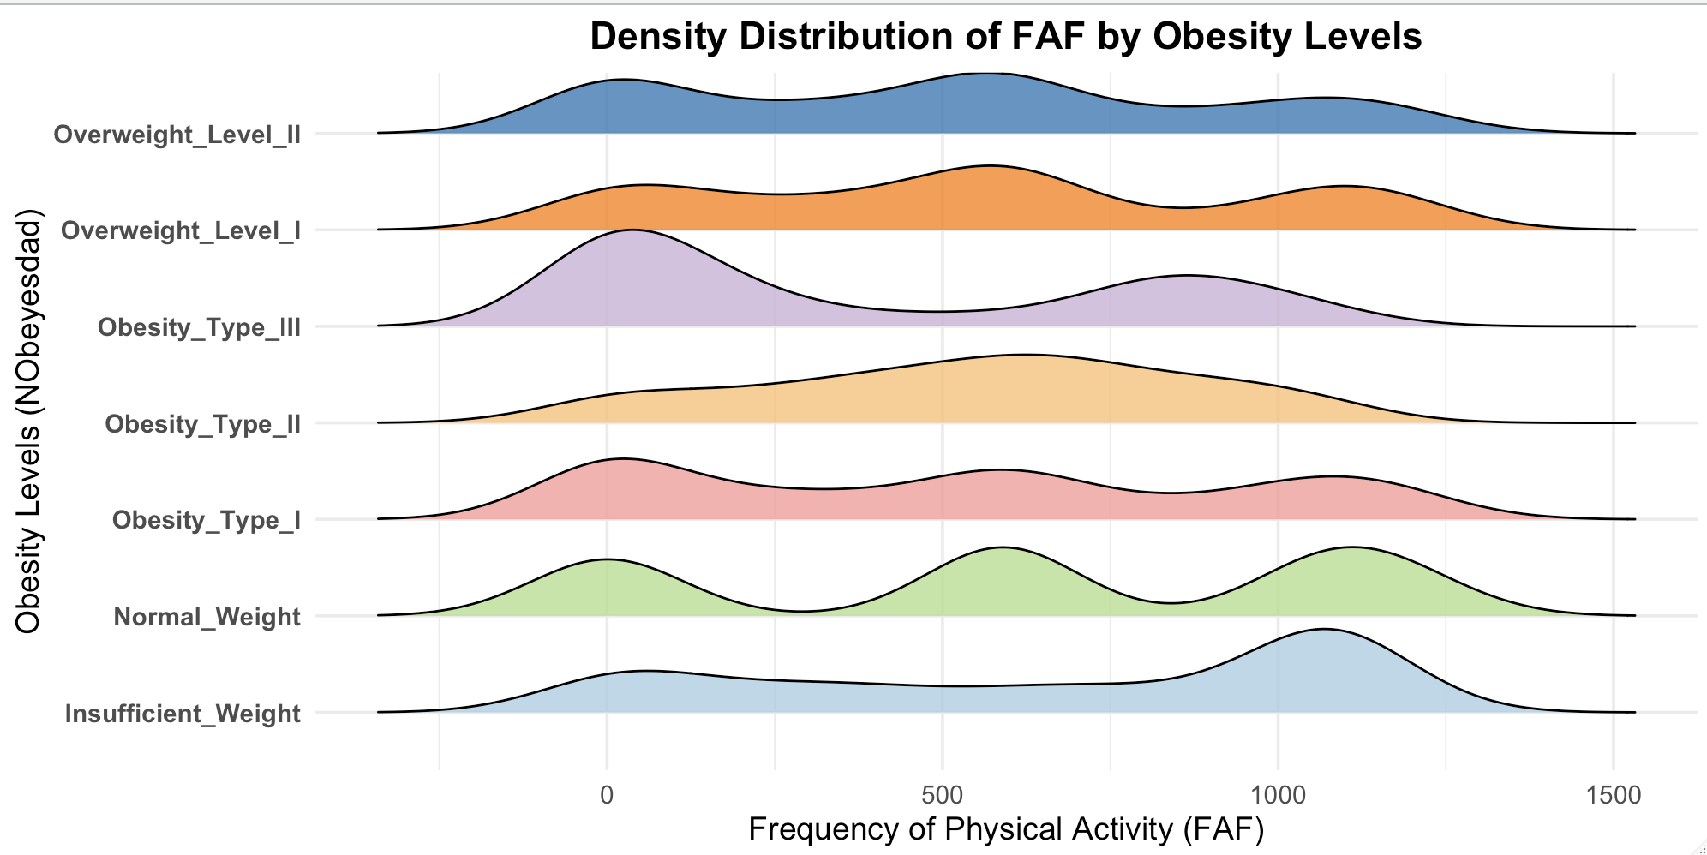
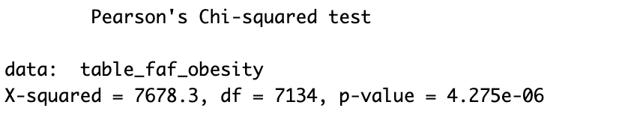
Research Hypothesis 2
Individuals with low physical activity levels have a higher likelihood of obesity than those with moderate to high activity levels.

Slide 13
Research Hypothesis 2
Individuals with low physical activity levels have a higher likelihood of obesity than those with moderate to high activity levels.
Findings from Physical Activity Frequency (FAF):
Individuals with low physical activity frequency (FAF = 0) are significantly more likely to fall into higher obesity categories
Statistical Evidence:
A significant negative correlation between Physical Activity Frequency (FAF) and obesity levels (from correlation analysis and regression models) indicates that as physical activity decreases, the likelihood of higher obesity levels increases.
The multinomial logistic regression further confirms that individuals with low activity levels are more likely to belong to obesity categories compared to those with moderate or high physical activity.
Mode of Transportation Analysis:
Non-active transportation modes (e.g., automobiles) are predominantly linked to higher obesity levels.
Active modes (e.g., walking) are associated with Normal Weight or Overweight_Level_I.
Conclusion:
The hypothesis is supported: Low physical activity levels significantly increase the likelihood of obesity, highlighting the importance of promoting moderate to high physical activity as part of public health strategies to combat obesity.

Slide 14
Research Question 2
What is the relationship between physical activity levels and obesity?
Correlation Analysis:
The correlation matrix shows a significant negative correlation (-0.65) between the mode of transportation (MTRANS) and obesity levels (NObeyesdad). This suggests that active transportation methods (e.g., walking, biking) are associated with lower obesity levels.
Chi-Square Test for Associations:
Variables related to physical activity, such as FAF (Physical Activity Frequency), are significantly associated with obesity levels. The relationship implies that reduced physical activity correlates with higher obesity levels.
Regression Analysis:
Multinomial logistic regression results suggest that lower levels of physical activity and sedentary transportation choices are strong predictors of higher obesity categories.
Conclusion:
Physical activity levels have a substantial inverse relationship with obesity. Encouraging more frequent physical activity and promoting active transportation can effectively mitigate obesity risks.

Slide 15
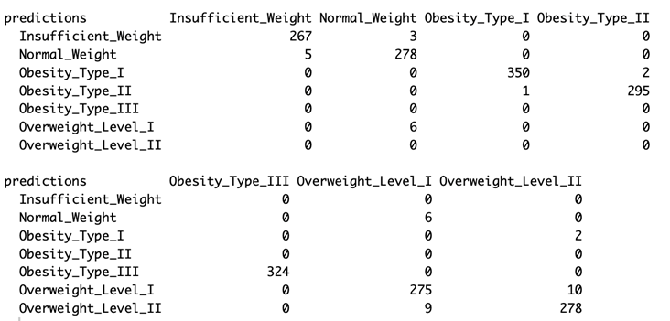
Prediction Model
Multinomial Logistic Regression to Predict Obesity Category:
Since the output of our prediction model consists of categorical data with 7 categories, we opted to use logistic regression.
We selected multinomial logistic regression because the output involves more than two categories.
We evaluated the model using a subset of the data and achieved an accuracy of 97.91%.

Slide 16
Conclusion
The study on the Estimation of Obesity Levels Based on Eating Habits and Physical Conditions provides critical insights into the relationships between lifestyle factors and obesity. Using the dataset, we examined dietary habits, physical activity, and other behavioral factors to identify their influence on obesity levels. Here are the key takeaways:
Dietary Habits and Obesity
Physical Activity and Obesity
Statistical Insights
Future Work:
Further analysis could explore the combined impact of psychological factors (e.g., stress coping capacity) and demographic variations (e.g., age, gender) on obesity.
Machine learning models could be applied for more precise obesity risk predictions.

